Slide 1
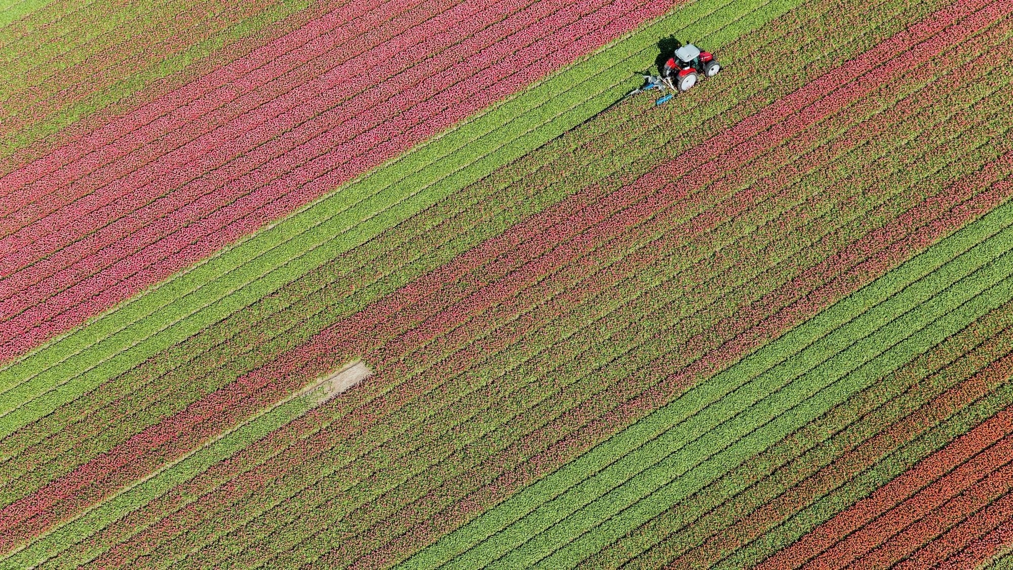
Protein Predictor
Urooj Ali
id : 131350
Professor: Azir Aliu

Slide 2
Project Overview
OBJECTIVE:
To build an interactive system that predicts the total protein content in user entered food.
KEY FEATURES:
Parses free-text input of food items and quantities.
Estimates total weight using heuristics
Predicts protein using a trained machine learning model.
Simple web interface using Flask.

Slide 3
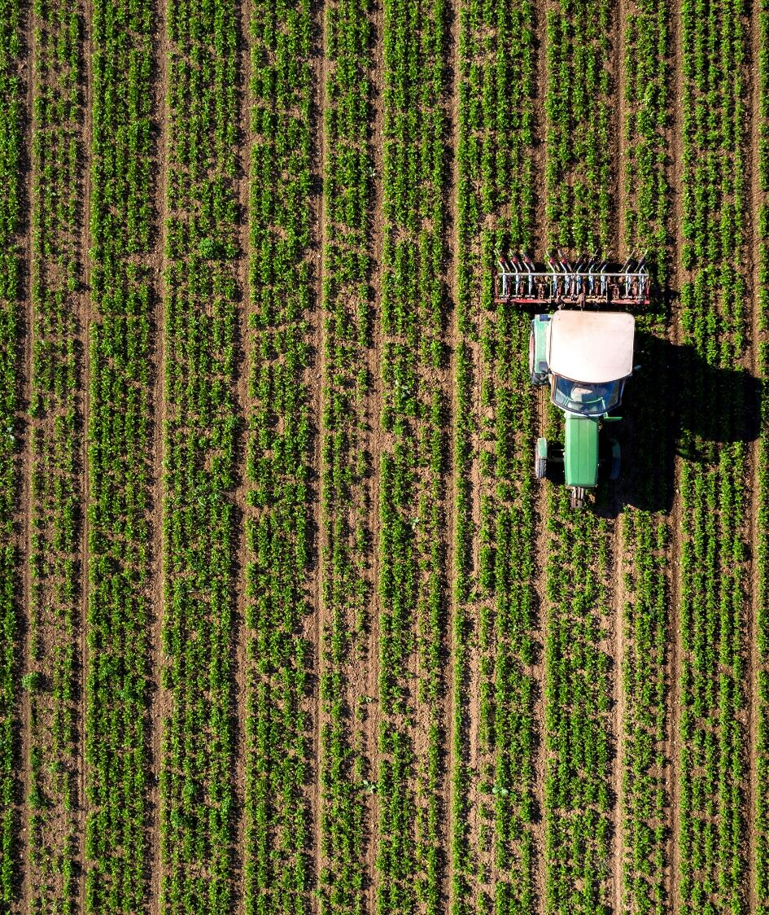
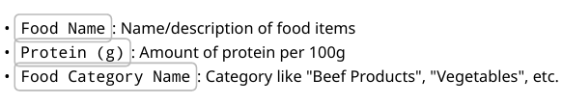
Database Description
Dataset Source:
USDA FoodData Central- Foundation Foods (CSV format).
Key Columns Used:
Data Cleaning:
Removed missing or irrelevant rows.
Removed duplicates.
Normalized food names (lowercase, punctuation removed)
Final Dataset Size:
~1300 rows after preprocessing

Slide 4
Problem Framing
ML Task Type: Supervised Regression
X=protein_data_grouped['Food_Name_Clean']
y = protein_data_grouped['Protein (g)']
Challenges:
Many variations in how foods are described ("egg", "eggs, large, boiled")
Mapping user-friendly input to model-understood format.
Avoiding overfitting on specific names

Slide 5
Preprocessing & Feature Engineering
Text Cleaning:
Lowercased Removed numbers, punctuation, extra spaces
Singularization Heuristic:
• E.g., "eggs" → "egg" (simple stemming to unify similar names)

Slide 6
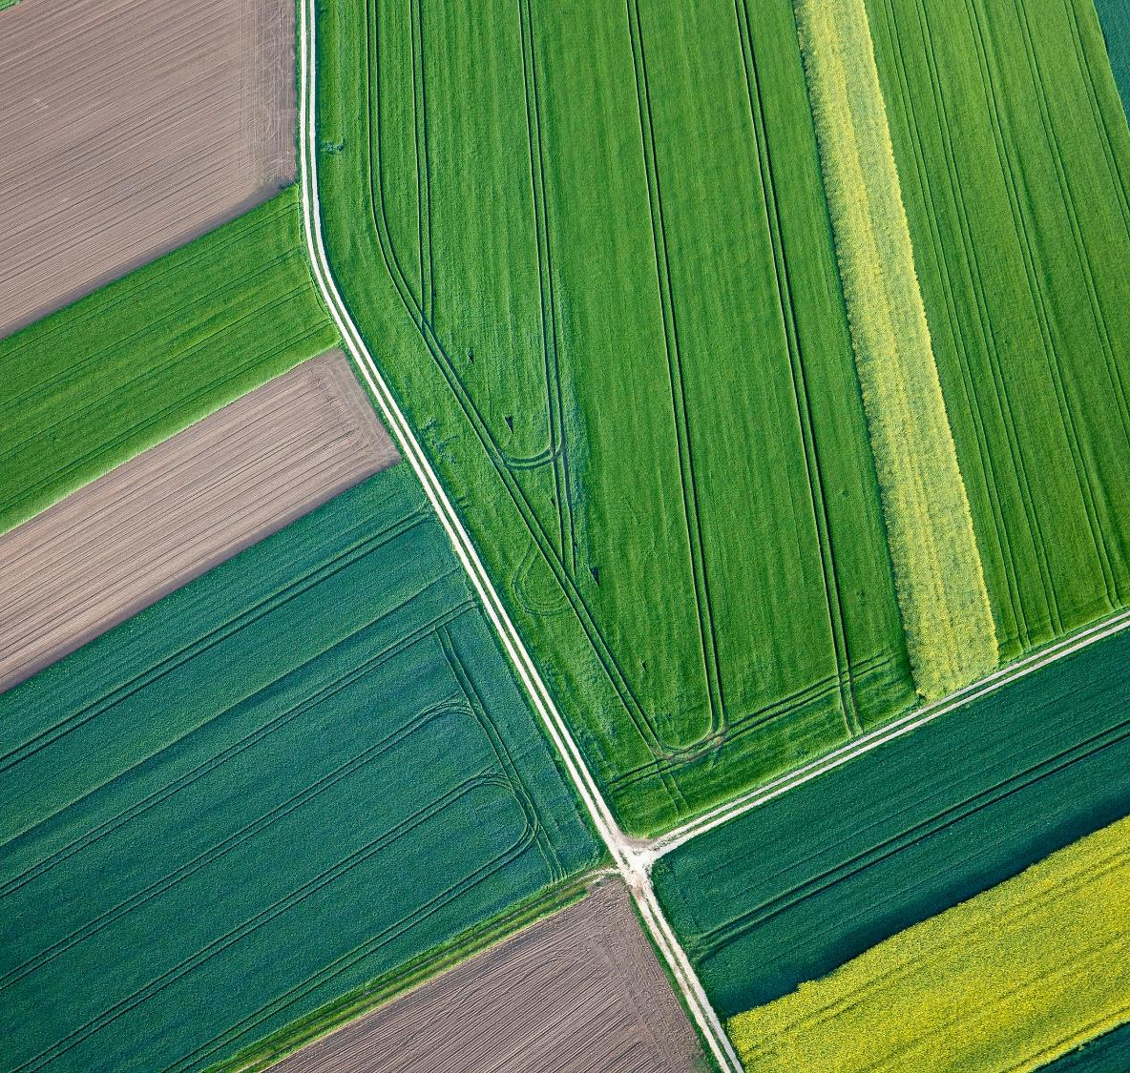
Model Selection and Training
Model Chosen: RandomForestRegressor Justification:
Nonlinear, robust to noisy text features. Works well with high-dimensional TF-IDF data. No scaling required
Training Workflow:
Train/test split: 80% training, 20% testing Target: Protein per 100g

Slide 7
Model Evaluation
Evaluation Metric:
Mean Absolute Error (MAE)
Results:
✅ Model Trained Successfully 🔍 RMSE: 2.894 📈
R² Score: 0.856 💾 Model and vectorizer saved!
Interpretation:
Low MAE indicates good approximation to actual values No significant overfitting detected.
Cross-Validation:
KFold (k=5) used to confirm generalization ability

Slide 8
User Input Parsing and Weight Estimation
Input Example: "2 eggs and 1 cup of milk“.
Parsing Process: Split by "and" Extract quantity, unit, and food name via regex
Weight Estimation:
• Predefined dictionary for average unit weights:
unit weights = {"egg": 50, "cup": 240, "slice": 30,}
• Multiply quantity by unit weight
Formula:
Total Protein = (Protein per 100g) × (Estimated Weight in g) ÷ 100

Slide 9
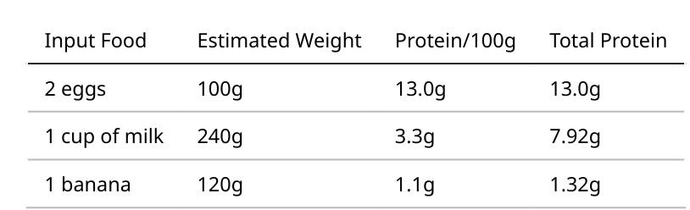
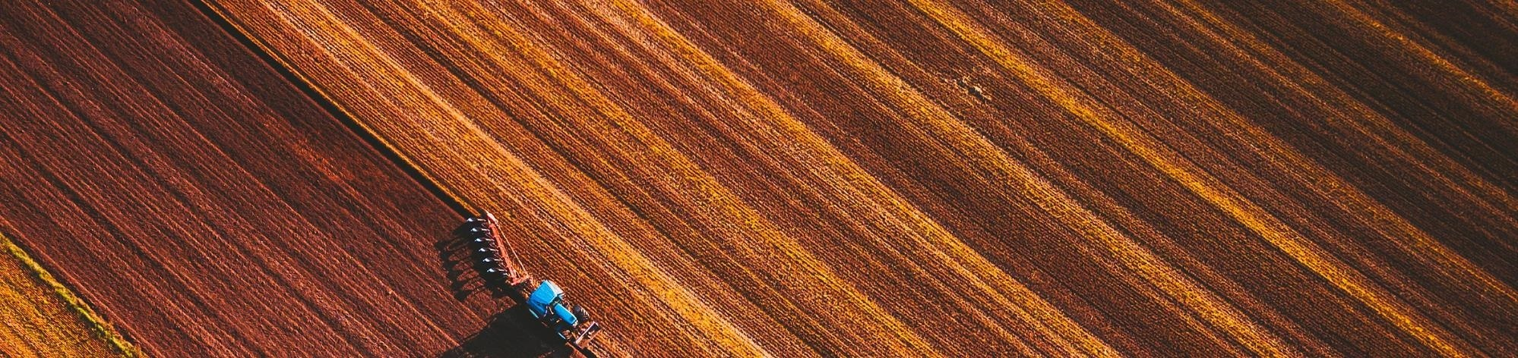
Sample Predictions
System outputs per-item breakdown and total protein sum.

Slide 10
Flask Web App Overview
Frontend: Simple input form to enter food items.
Backend Logic:
Cleans and parses input Applies unit weight estimation
Uses vectorizer + model to predict protein
Displays result in HTML table
Optional Visualization:
Interactive histogram of protein distribution by category (using ipywidgets + seaborn)

Slide 11
Challenges Faced
Ambiguity in user input: e.g., "1 bowl" or "some rice“.
Model accuracy depends on text similarity with training data
Unit estimation is heuristic-based and not exact

Slide 12
Conclusion
Successfully trained a Random Forest Regressor to predict protein
Combined machine learning with rule-based parsing and UI
Model is light, fast, and can be extended easily
Result: A usable and educational ML-powered food nutrition estimator.

Slide 13
Thank You

